Slide 1
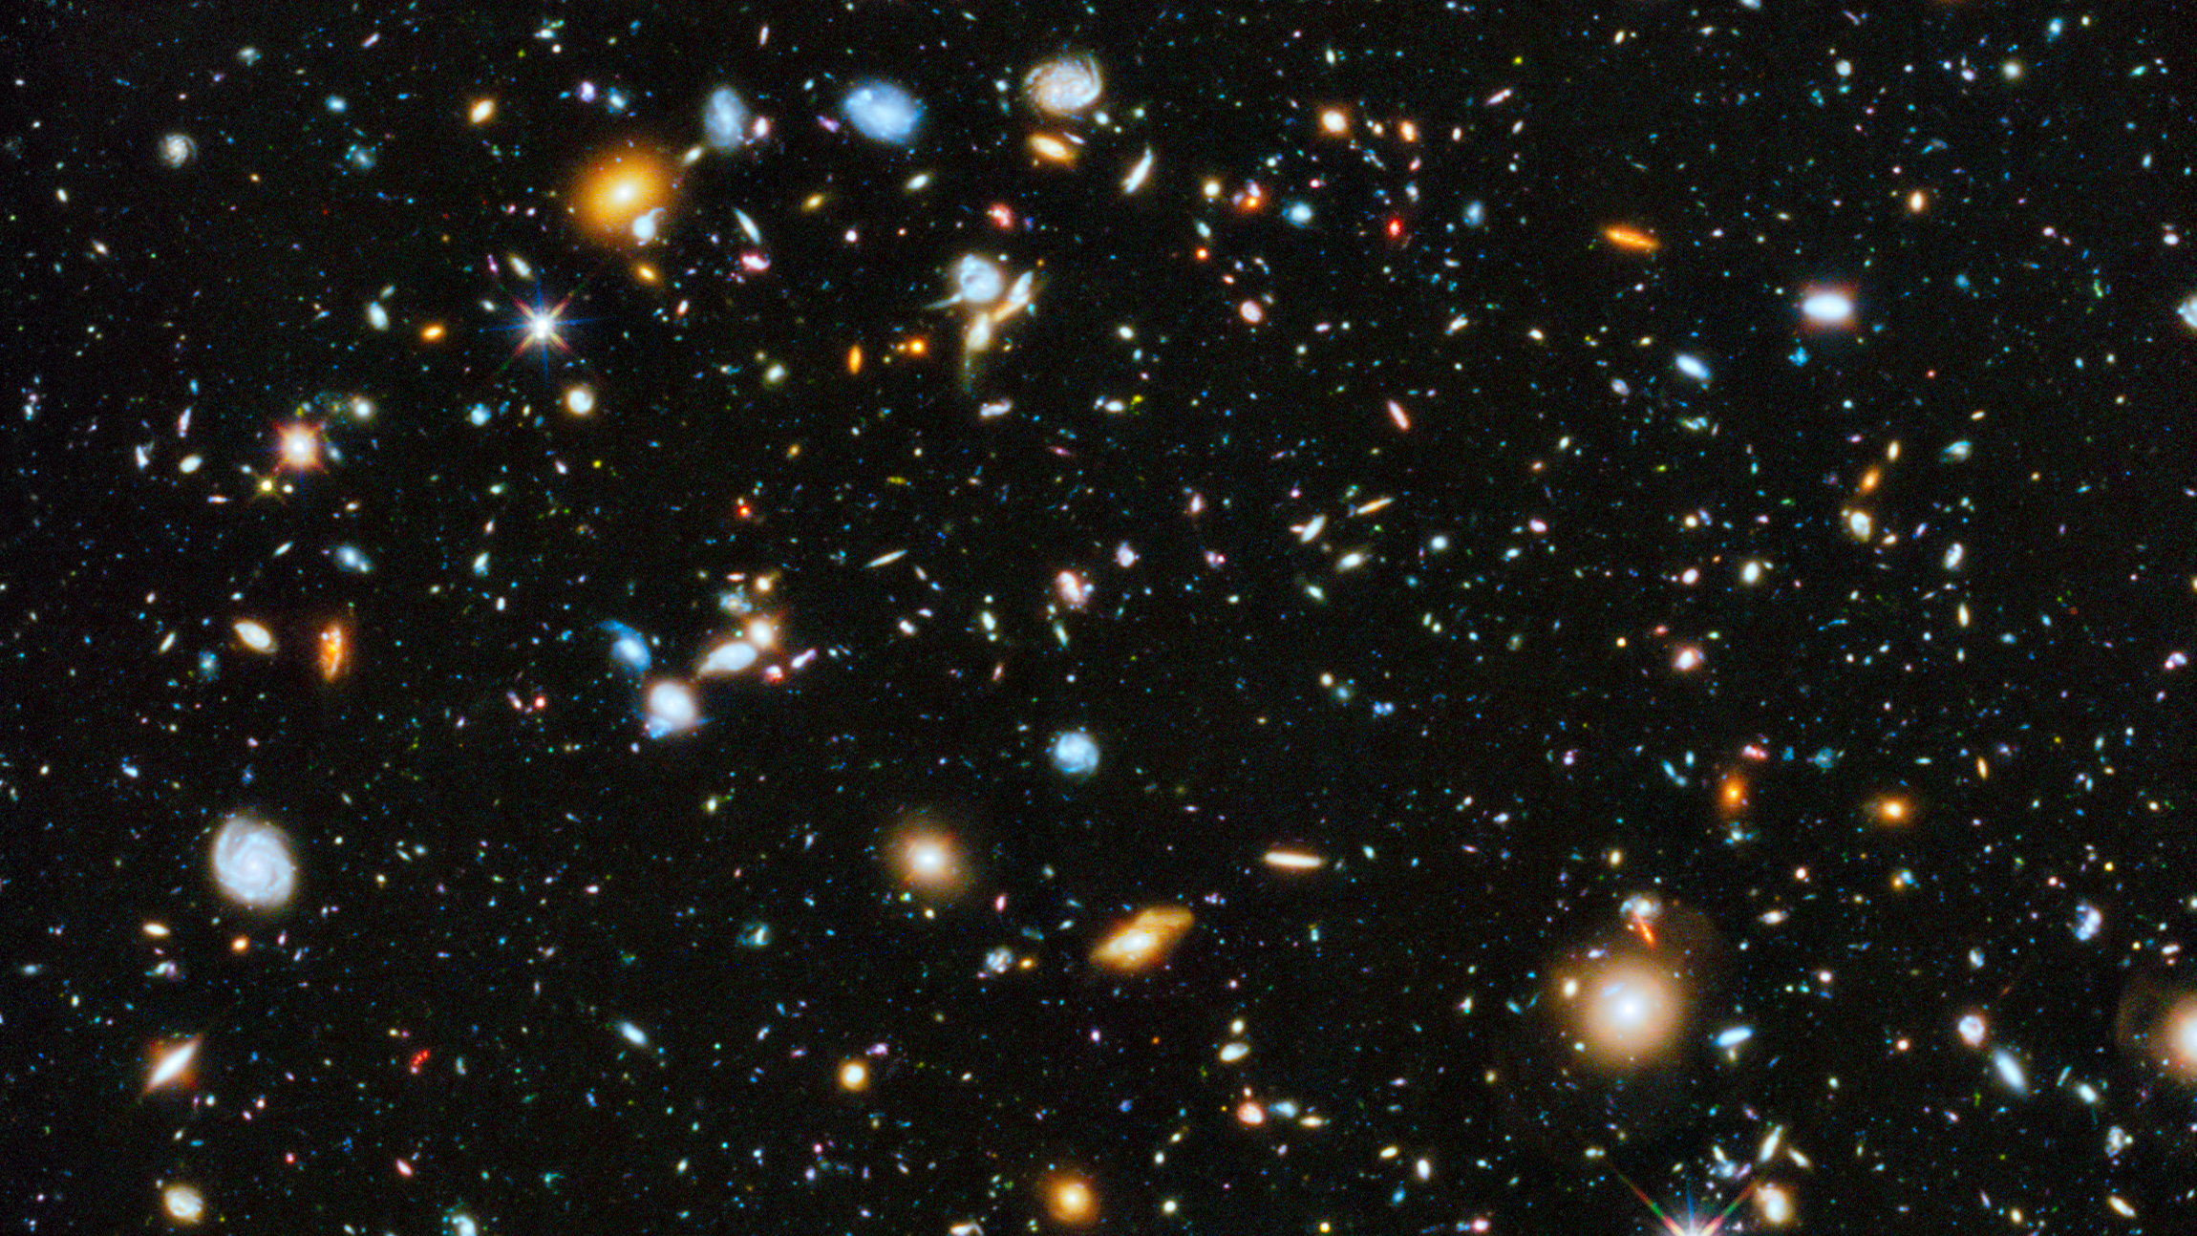
Notes:
https://hubblesite.org/contents/news-releases/2014/news-2014-27.html
CREDITS:Image: NASA, ESA, H. Teplitz and M. Rafelski (IPAC/Caltech), A. Koekemoer (STScI), R. Windhorst (Arizona State University), and Z. Levay (STScI); Science: NASA, ESA, H. Teplitz and M. Rafelski (IPAC/Caltech), P. Kurczynski (Rutgers University), N. Bond (Goddard Space Flight Center), E. Soto (Catholic University), N. Grogin and A. Koekemoer (STScI), H. Atek (École Polytechnique Fédérale de Lausanne, Switzerland), T. Brown and D. Coe (STScI), J. Colbert and Y. Dai (IPAC/Caltech), H. Ferguson (STScI), S. Finkelstein (University of Texas, Austin), J. Gardner (Goddard Space Flight Center), E. Gawiser (Rutgers University), M. Giavalisco (University of Massachusetts, Amherst), C. Gronwall (Penn State University), D. Hanish (IPAC/Caltech), K.-S. Lee (Purdue University), Z. Levay (STScI), D. De Mello (Catholic University), S. Ravindranath and R. Ryan (STScI), B. Siana (University of California, Riverside), C. Scarlata (University of Minnesota, Minneapolis), E. Voyer (CNRS, Marseille), and R. Windhorst (Arizona State University)

Slide 2
Problems

Slide 3
Distance
Height
Length
Problems

Slide 4
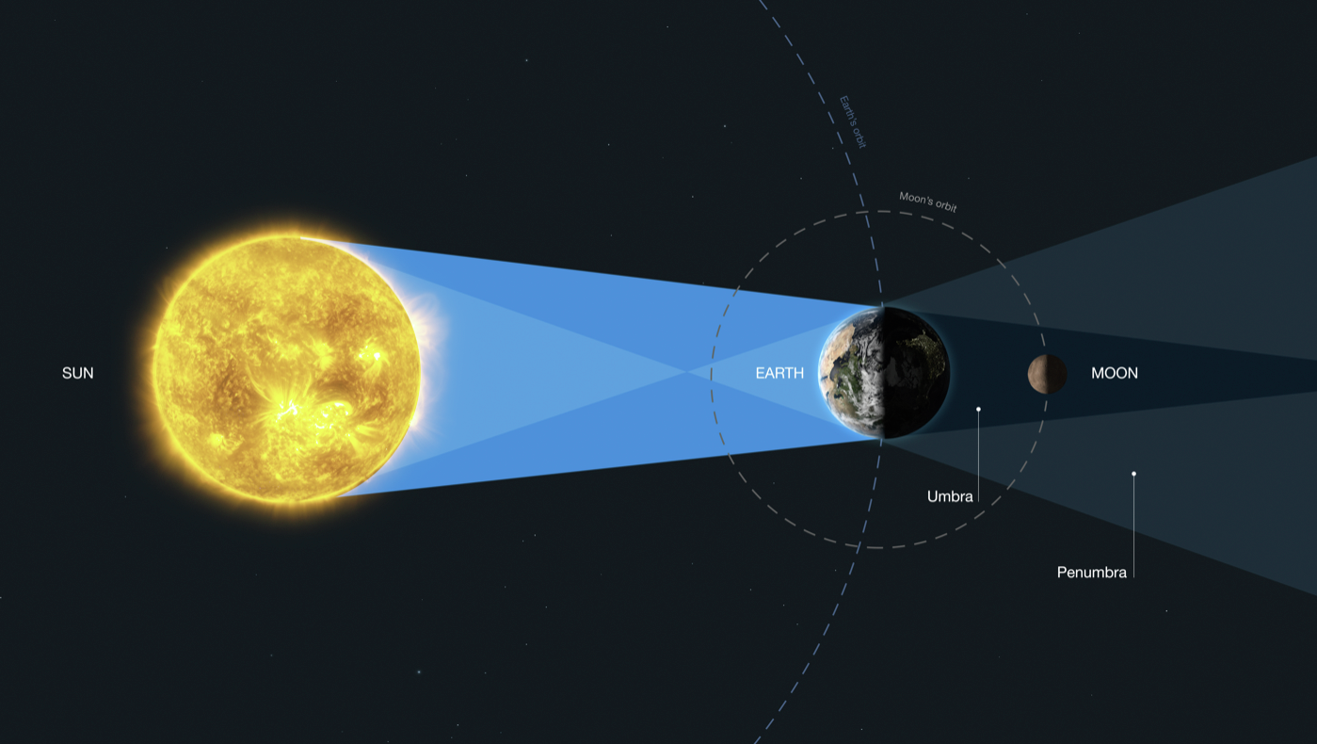
Moon’s Distance to Sun:
Notes:
https://hubblesite.org/contents/media/images/2020/30/4716-Image
M. Kornmesser (ESA/Hubble), NASA, and ESA

Slide 5
Moon’s Distance to Sun: How many Earth?
Notes:
Earth’s 12,742 km

Slide 6
Moon’s Distance to Sun: How many Earth?
Notes:
Earth’s 12,742 km

Slide 7
Moon’s Distance to Sun: How many Earth?
Notes:
Earth’s 12,742 km

Slide 8
Moon’s Distance to Sun: How many Earth?
Notes:
Earth’s 12,742 km

Slide 9
Moon’s Distance to Sun
Moon’s Distance to Sun: How many Earth?
Notes:
Earth’s 12,742 km

Slide 10
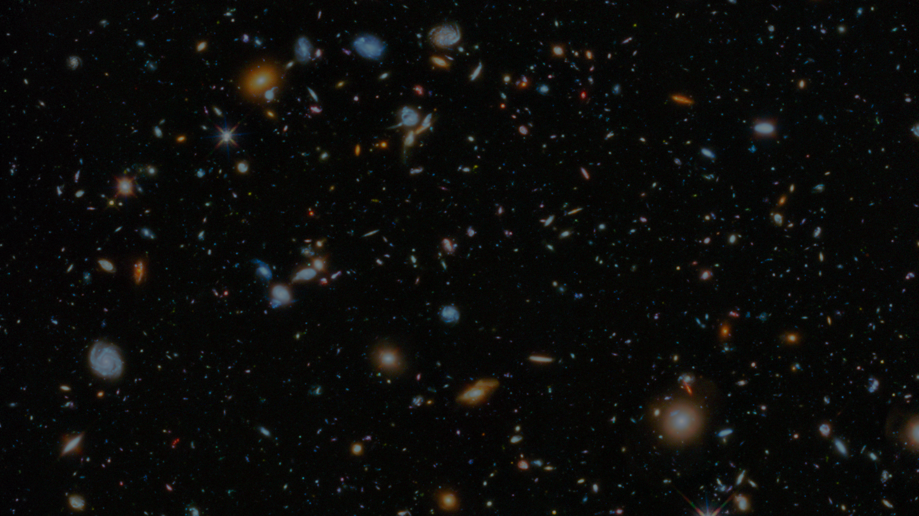
Continuous
Discrete

Slide 11
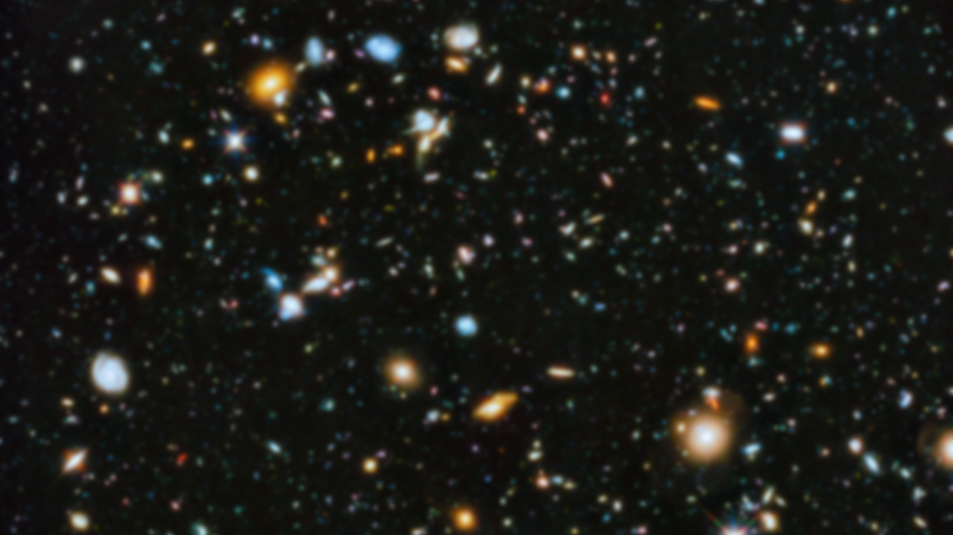
Discrete systems

Slide 12
Poll
Click to Open the Poll
Notes:
For the instructor to start the poll:
https://directpoll.com/c?XDVhEt59x2nMuWEWMsPyI4JjAMFnDPxY8
For the instructor to show the replies and correct answer:
https://www.directpoll.com/r?XDbzPBd3ixYqg8XgchMp4tObJpS7kJlGp1oGe4VDd5
For students: http://etc.ch/mYUq

Slide 13
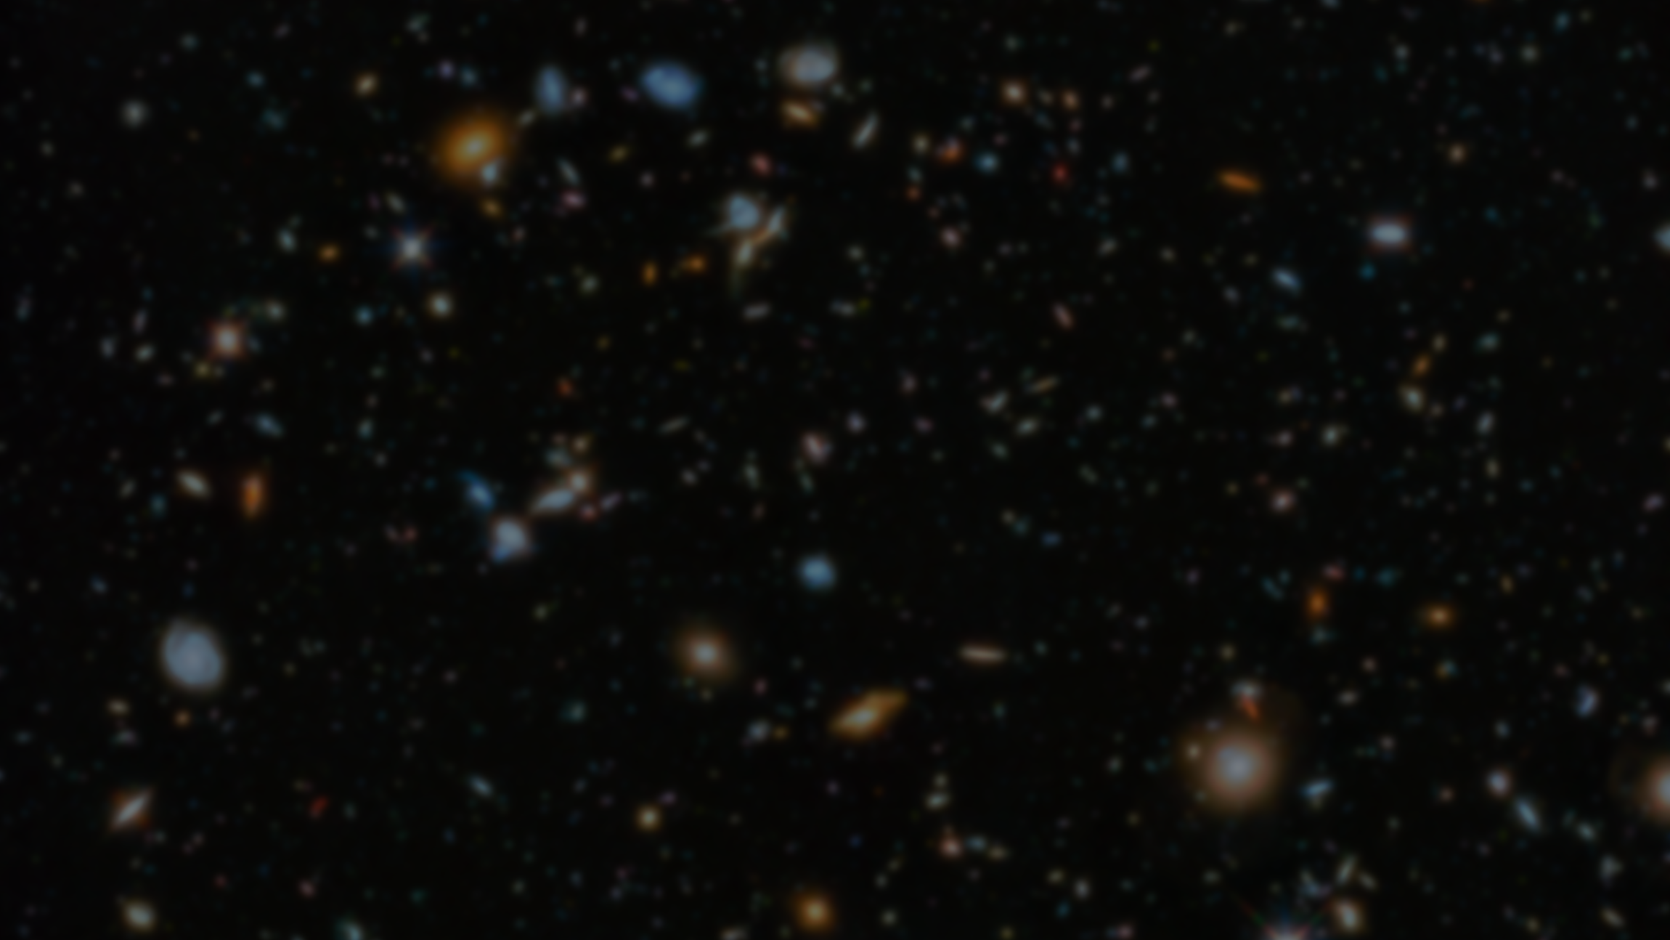
Star | Continuous | Discrete
Temperature | Continuous | Discrete
Electron | Continuous | Discrete
Time | Continuous | Discrete
Weight | Continuous | Discrete
Speed | Continuous | Discrete
Student | Continuous | Discrete
Sound | Continuous | Discrete
Image | Continuous | Discrete
Pain | Continuous | Discrete
Light | Continuous | Discrete
Wave | Continuous | Discrete

Slide 14
Star |  | Discrete
Temperature | Continuous
Electron |  | Discrete
Time | Continuous
Weight | Continuous
Speed | Continuous
Student |  | Discrete
Sound | Continuous
Image | Continuous | Discrete
Pain | Continuous | Discrete
Light | Continuous | Discrete
Wave | Continuous

Slide 15
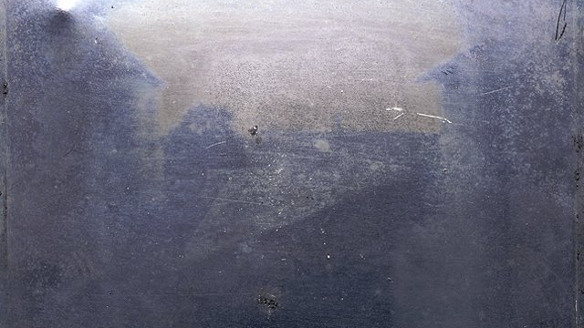
“The world's first photograph—or at least the oldest surviving photo—was taken by Joseph Nicéphore Niépce in 1826 or 1827. Captured using a technique known as heliography, the shot was taken from an upstairs window at Niépce's estate in Burgundy. As heliography produces one-of-a-kind images, there are no duplicates of the piece, which is now part of the permanent collection at the University of Texas-Austin.” 18 Famous First Photographs in History: From the Oldest Photo Ever to the World’s First Instagram
Notes:
https://mymodernmet.com/first-photograph-photography-history/#:~:text=The%20world's%20first%20photograph%E2%80%94or,at%20Ni%C3%A9pce's%20estate%20in%20Burgundy.

Slide 16
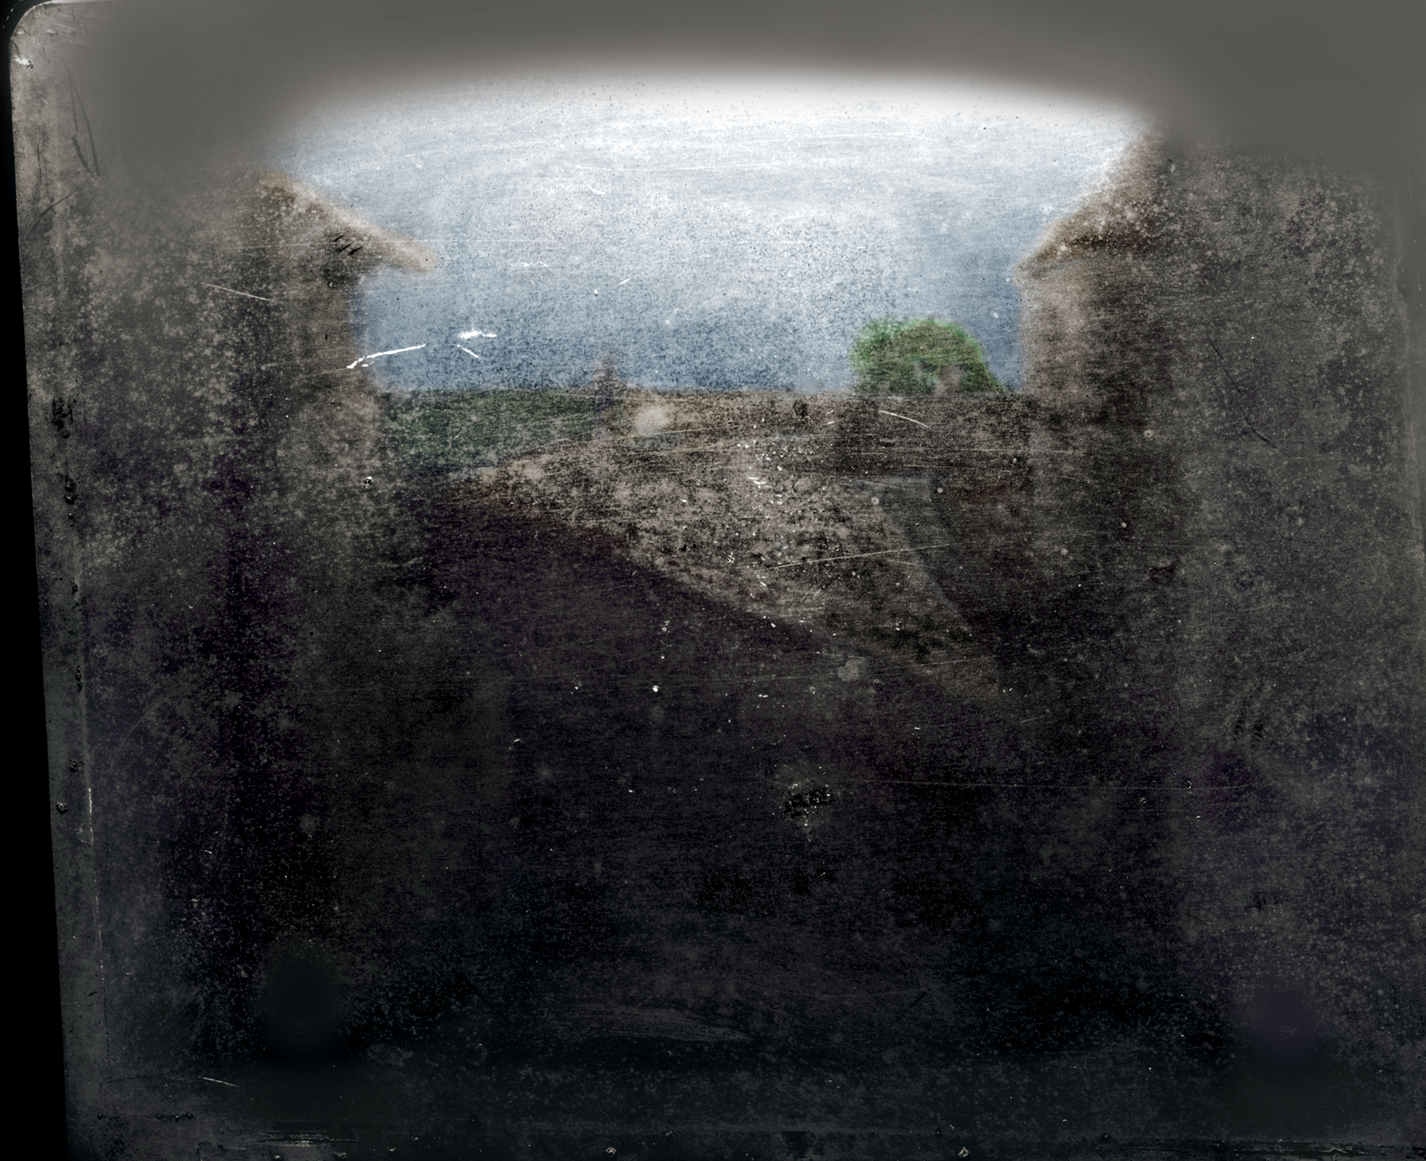

Slide 17
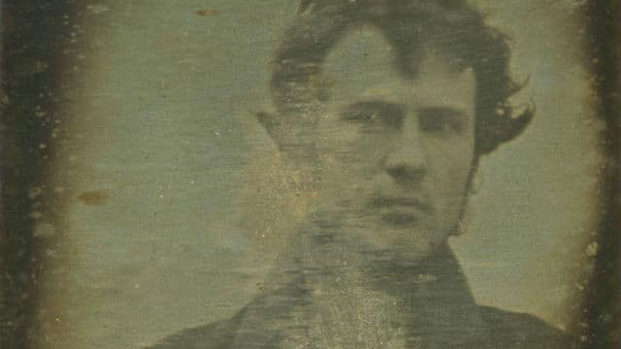
“We may be used to selfies now, but it's Robert Cornelius's 1839 image that lays claim to the first self-portrait. Taken in Philadelphia, Cornelius sat for a little over one minute before covering the lens.” 18 Famous First Photographs in History: From the Oldest Photo Ever to the World’s First Instagram

Slide 18
Moon’s Distance to Sun: [empty]
Notes:
https://hubblesite.org/contents/media/images/2020/30/4716-Image
M. Kornmesser (ESA/Hubble), NASA, and ESA

Slide 19
I
Moon’s Distance to Sun: I
Notes:
Earth’s 12,742 km

Slide 20
I
I
Moon’s Distance to Sun: II
Notes:
Earth’s 12,742 km

Slide 21
I
I
I
Moon’s Distance to Sun: III
Notes:
Earth’s 12,742 km

Slide 22
Continuous
Analog
Discrete
Numbers
Digital
Quantization

Slide 23
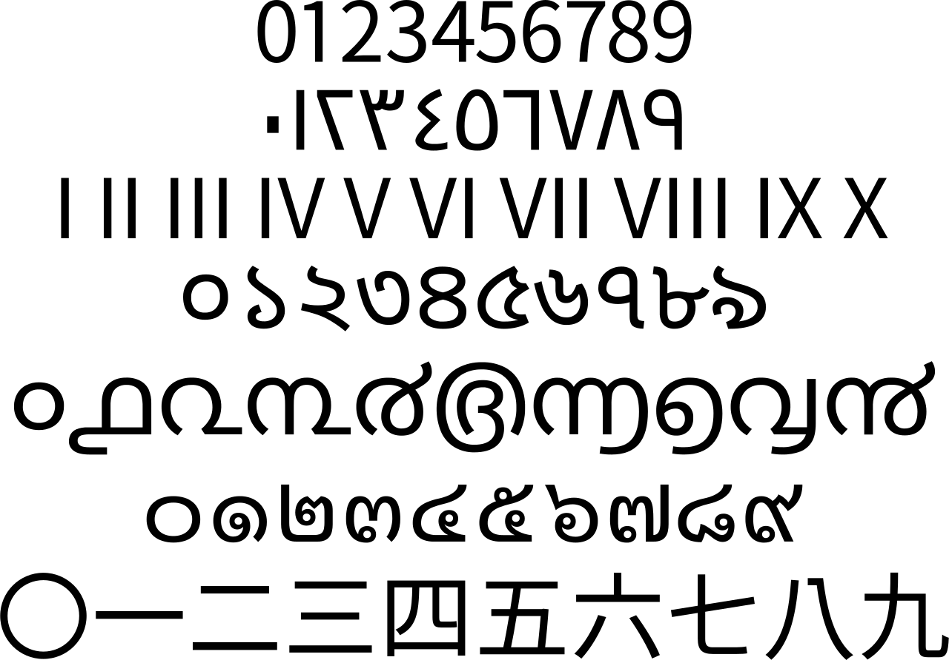
Roman Numerals
Originated in Ancient Rome
8th Century BC
Notes:
Roman numerals (Roman numerals are a numeral system that originated in ancient Rome )

Slide 24
Unary system
aka. Base-1
Notes:
The unary numeral system is the bijective base-1 numeral system. It is the simplest numeral system to represent natural numbers:^{[1]} in order to represent a number N, an arbitrarily chosen symbol representing 1 is repeated N times.[

Slide 25
how many positions to represent the moon’s distance to the sun if an Oracle said it is ~150 million km and earth’s diameter is ~13,000 km?
Notes:
For the instructor to start the poll:
https://directpoll.com/c?XDVhEt59x2nMuWEWMsPyI4JjAMFnDPxY8
For the instructor to show the replies and correct answer:
https://www.directpoll.com/r?XDbzPBd3ixYqg8XgchMp4tObJpS7kJlGp1oGe4VDd5
For students: http://etc.ch/mYUq

Slide 26
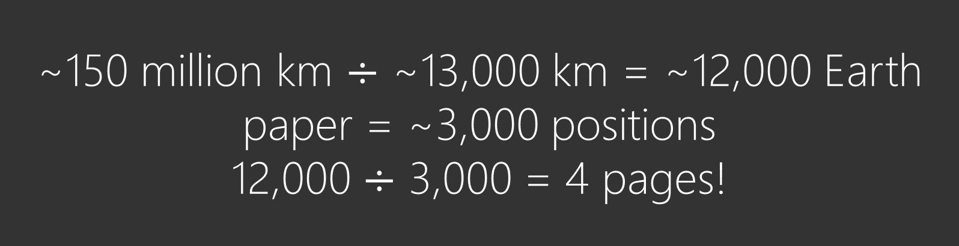
~150 million km $÷$ ~13,000 km = ~12,000 Earth
paper = ~3,000 positions
12,000 $÷$ 3,000 = 4 pages!
IIIIIIIIIIIIIIIIIIIIIIIIIIIIIIIIIIIIIIIIIIIIIIIIIIIIIIIIIIIIIIIIIIIIIIIIIII
IIIIIIIIIIIIIIIIIIIIIIIIIIIIIIIIIIIIIIIIIIIIIIIIIIIIIIIIIIIIIIIIIIIIIIIIIII
IIIIIIIIIIIIIIIIIIIIIIIIIIIIIIIIIIIIIIIIIIIIIIIIIIIIIIIIIIIIIIIIIIIIIIIIIII
IIIIIIIIIIIIIIIIIIIIIIIIIIIIIIIIIIIIIIIIIIIIIIIIIIIIIIIIIIIIIIIIIIIIIIIIIII

Slide 27
Number systems
Notes:
A numeral system (or system of numeration) is a writing system for expressing numbers; that is, a mathematical notation for representing numbers of a given set, using digits or other symbols in a consistent manner.

Slide 28
3rd and 7th century AD
Notes:
https://en.wikipedia.org/wiki/Arabic_numerals#/media/File:The_Brahmi_numeral_system_and_its_descendants.png

Slide 29
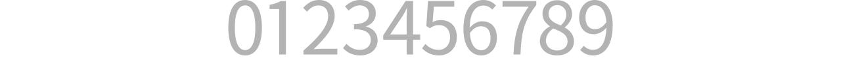
Hossein’s Number System
Notes:
https://en.wikipedia.org/wiki/Arabic_numerals :
Quaternary kwaa·tur·neh·ree

Slide 30
0
Moon’s Distance to Sun: 0
Notes:
Earth’s 12,742 km

Slide 31
1
0
Moon’s Distance to Sun: 1
Notes:
Earth’s 12,742 km

Slide 32
2
1
0
Moon’s Distance to Sun: 2
Notes:
Earth’s 12,742 km

Slide 33
3
2
1
0
Moon’s Distance to Sun: 3
Notes:
Earth’s 12,742 km

Slide 34
4
3
2
1
0
Moon’s Distance to Sun: 3+1
Notes:
Earth’s 12,742 km

Slide 35
?
?
3
2
1
0
Moon’s Distance to Sun: 3+2
Notes:
Earth’s 12,742 km

Slide 36
More Position
 |  | 0 | 0
 |  | 1 | 1
 |  | 2 | 2
 |  | 3 | 3
 | 3 | 0 | 4
 | 3 | 1 | 5
 | 3 | 2 | 6
 | 3 | 3 | 7
3 | 3 | 0 | 8

Slide 37
0 | 0
1 | 1
2 | 2
3 | 3
4 | 0 | 3
5 | 1 | 3
6 | 2 | 3
7 | 3 | 3
8 | 0 | 3 | 3
More Position

Slide 38
More Position
 |  | 3 | 3 | 0 | 8
 |  | 3 | 3 | 1 | 9
 |  | 3 | 3 | 2 | 10
 |  | 3 | 3 | 3 | 11
 | 3 | 3 | 3 | 0 | 12
 | 3 | 3 | 3 | 1 | 13
 | 3 | 3 | 3 | 2 | 14
 | 3 | 3 | 3 | 3 | 15
3 | 3 | 3 | 3 | 0 | 16

Slide 39
More Position
 |  |  |  | 0 | (1-1)=0
 |  |  |  | 1 | 1+(1-1)=1
 |  |  |  | 2 | 2+(1-1)=2
 |  |  |  | 3 | 3+(1-1)=3
 |  |  | 3 | 0 | 3+0+(2-1)=4
 |  |  | 3 | 1 | 3+1+(2-1)=5
 |  |  | 3 | 2 | 3+2+(2-1)=6
 |  |  | 3 | 3 | 3+3+(2-1)=7
 |  | 3 | 3 | 0 | 3+3+(3-1)=8

Slide 40
More Position
 |  | 3 | 3 | 0 | 3+3+0+(3-1)=8
 |  | 3 | 3 | 1 | 3+3+1+(3-1)=9
 |  | 3 | 3 | 2 | 3+3+2+(3-1)=10
 |  | 3 | 3 | 3 | 3+3+3+(3-1)=11
 | 3 | 3 | 3 | 0 | 3+3+3+0+(4-1)=12
 | 3 | 3 | 3 | 1 | 3+3+3+1+(4-1)=13
 | 3 | 3 | 3 | 2 | 3+3+3+2+(4-1)=14
 | 3 | 3 | 3 | 3 | 3+3+3+3+(4-1)=15
3 | 3 | 3 | 3 | 0 | 3+3+3+3+(5-1)=16

Slide 41
More Position
 |  | 3 | 0 | 3 | 0 | 2 | 1 | 3 | 1 | ?
 |  |  |  |  | 3 | 3 | 3 | 3 | 1 | ?
 |  |  |  | 3 | 3 | 3 | 3 | 3 | 2 | ?
 |  | 3 | 0 | 0 | 3 | 3 | 3 | 3 | 0 | ?
3 | 3 | 3 | 3 | 3 | 3 | 3 | 3 | 3 | 3 | ?
Notes:
For the instructor to start the poll:
https://directpoll.com/c?XDVhEt59x2nMuWEWMsPyI4JjAMFnDPxY8
For the instructor to show the replies and correct answer:
https://www.directpoll.com/r?XDbzPBd3ixYqg8XgchMp4tObJpS7kJlGp1oGe4VDd5
For students: http://etc.ch/mYUq

Slide 42
More Position
 |  | 3 | 0 | 3 | 0 | 2 | 1 | 3 | 1 | -
 |  |  |  |  | 3 | 3 | 3 | 3 | 1 | ?
 |  |  |  | 3 | 3 | 3 | 3 | 3 | 2 | ?
 |  | 3 | 0 | 0 | 3 | 3 | 3 | 3 | 0 | ?
3 | 3 | 3 | 3 | 3 | 3 | 3 | 3 | 3 | 3 | ?

Slide 43
More Position
 |  | 3 | 0 | 3 | 0 | 2 | 1 | 3 | 1 | -
 |  |  |  |  | 3 | 3 | 3 | 3 | 1 | ? | 3*4+1+(5-1)
 |  |  |  | 3 | 3 | 3 | 3 | 3 | 2 | ?
 |  | 3 | 0 | 0 | 3 | 3 | 3 | 3 | 0 | ?
3 | 3 | 3 | 3 | 3 | 3 | 3 | 3 | 3 | 3 | ?

Slide 44
More Position
 |  | 3 | 0 | 3 | 0 | 2 | 1 | 3 | 1 | -
 |  |  |  |  | 3 | 3 | 3 | 3 | 1 | 17
 |  |  |  | 3 | 3 | 3 | 3 | 3 | 2 | 22
 |  | 3 | 0 | 0 | 3 | 3 | 3 | 3 | 0 | -
3 | 3 | 3 | 3 | 3 | 3 | 3 | 3 | 3 | 3 | 39

Slide 45
0 | 0 | … | 0 | 0 | 0
Min
n positions
Max
3 | 3 | … | 3 | 3 | ?

Slide 46
3+3+3+…+3+(n−1) = 3×n +(n−1)=4n−1
n positions
Max
3 | 3 | … | 3 | 3 | 4n+1

Slide 47
Max = 4n−1
n=10 ⇒ (4×10)−1 = 39
10 positions
Max
3 | 3 | … | 3 | 3 | 39

Slide 48
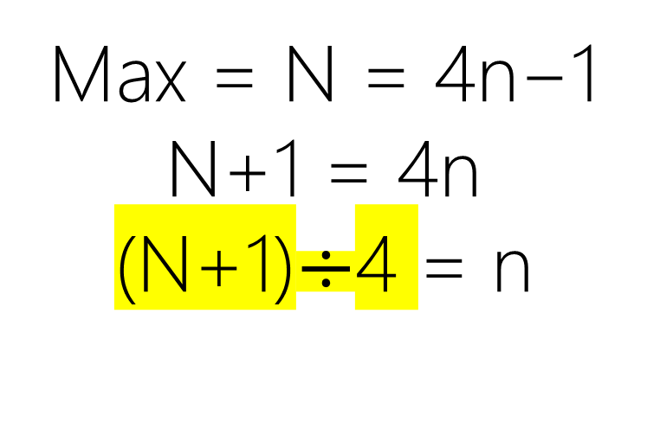
Max = N = 4n−1
N+1 = 4n
(N+1)$÷$4 = n
? positions
Max
3 | 3 | … | 3 | 3 | N

Slide 49
how many positions to represent the moon’s distance to the sun in Hossein’s system if an Oracle said it is ~150 million km and earth’s diameter is ~13,000 km?

Slide 50
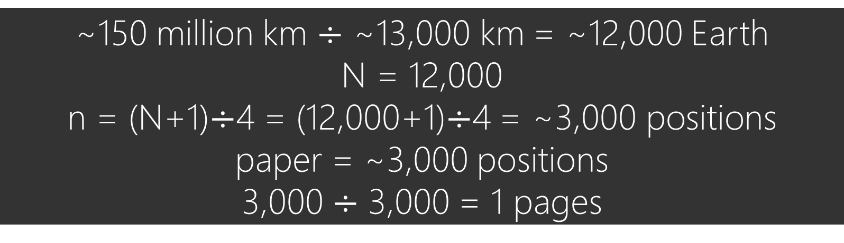
~150 million km $÷$ ~13,000 km = ~12,000 Earth
N = 12,000
n = (N+1)$÷$4 = (12,000+1)$÷$4 = ~3,000 positions
paper = ~3,000 positions
3,000 $÷$ 3,000 = 1 pages
IIIIIIIIIIIIIIIIIIIIIIIIIIIIIIIIIIIIIIIIIIIIIIIIIIIIIIIIIIIIIIIIIIIIIIIIIII
IIIIIIIIIIIIIIIIIIIIIIIIIIIIIIIIIIIIIIIIIIIIIIIIIIIIIIIIIIIIIIIIIIIIIIIIIII
IIIIIIIIIIIIIIIIIIIIIIIIIIIIIIIIIIIIIIIIIIIIIIIIIIIIIIIIIIIIIIIIIIIIIIIIIII
IIIIIIIIIIIIIIIIIIIIIIIIIIIIIIIIIIIIIIIIIIIIIIIIIIIIIIIIIIIIIIIIIIIIIIIIIII
3333333333333333333333333333333333333333
Notes:
For the instructor to start the poll:
https://directpoll.com/c?XDVhEt59x2nMuWEWMsPyI4JjAMFnDPxY8
For the instructor to show the replies and correct answer:
https://www.directpoll.com/r?XDbzPBd3ixYqg8XgchMp4tObJpS7kJlGp1oGe4VDd5
For students: http://etc.ch/mYUq

Slide 51
More Position
 |  |  |  | 0 | 0
 |  |  |  | 1 | 1
 |  |  |  | 2 | 2
 |  |  |  | 3 | 3
 |  |  | 3 | 0 | 4
 |  |  | 3 | 1 | 5
 |  |  | 3 | 2 | 6
 |  |  | 3 | 3 | 7
 |  | 3 | 3 | 0 | 8
1 rounds of all (4) symbols: 1 × 4
2 rounds of all (4) symbols: 2 × 4

Slide 52
2 rounds of all (4) symbols: 2 × 4
 |  | 3 | 3 | 0 | 8
 |  | 3 | 3 | 1 | 9
 |  | 3 | 3 | 2 | 10
 |  | 3 | 3 | 3 | 11
 | 3 | 3 | 3 | 0 | 12
 | 3 | 3 | 3 | 1 | 13
 | 3 | 3 | 3 | 2 | 14
 | 3 | 3 | 3 | 3 | 15
3 | 3 | 3 | 3 | 0 | 16
3 rounds of all (4) symbols: 3 × 4
4 rounds of all (4) symbols: 4 × 4

Slide 53
More Significant Position
 |  | 0 | 0
 |  | 1 | 1
 |  | 2 | 2
 |  | 3 | 3
 | 1 | 0 | 4
 | 1 | 1 | 5
 | 1 | 2 | 6
 | 1 | 3 | 7
 | 2 | 0 | 8
4¹ More Significant
1 round of all (4) symbols = 1×4¹
4¹ More Significant
2 rounds of all (4) symbols = 2×4¹

Slide 54
2 rounds of all (4) symbols = 2×4¹
 |  |  | 2 | 0 | 8
 |  |  | 2 | 1 | 9
 |  |  | 2 | 2 | 10
 |  |  | 2 | 3 | 11
 |  |  | 3 | 0 | 12
 |  |  | 3 | 1 | 13
 |  |  | 3 | 2 | 14
 |  |  | 3 | 3 | 15
 |  |  | ? | ? | 16
4¹ More Significant
3 rounds of all (4) symbols = 3×4¹

Slide 55
 |  |  | 2 | 0 | 8
 |  |  | 2 | 1 | 9
 |  |  | 2 | 2 | 10
 |  |  | 2 | 3 | 11
 |  |  | 3 | 0 | 12
 |  |  | 3 | 1 | 13
 |  |  | 3 | 2 | 14
 |  |  | 3 | 3 | 15
 |  | 1 | 0 |  | 16
1 rounds of all (4) symbols in the 2nd significant position
= 4×4¹ = 1×4²

Slide 56
 |  |  | 2 | 0 | 8
 |  |  | 2 | 1 | 9
 |  |  | 2 | 2 | 10
 |  |  | 2 | 3 | 11
 |  |  | 3 | 0 | 12
 |  |  | 3 | 1 | 13
 |  |  | 3 | 2 | 14
 |  |  | 3 | 3 | 15
 |  | 1 | 0 | 0 | 16
4² More Significant
1 rounds of all (4) symbols in the more significant position
= 4×4¹ = 1×4²

Slide 57
Quaternary system
(0,1,2,3)₄
/kwaa·tur·neh·ree/
aka. Base-4, Radix-4
Hindu-Arabic Numerals
Originated in India
7th Century AD
Notes:
https://en.wikipedia.org/wiki/Arabic_numerals :
Quaternary kwaa·tur·neh·ree

Slide 58
More Significant Position
 |  |  | 4⁰
 |  |  | 0 | 0×4⁰=0
 |  |  | 1 | 1×4⁰=1
 |  |  | 2 | 2×4⁰=2
 |  |  | 3 | 3×4⁰=3
#Symbols=4
Radix-4
Base-4

Slide 59
More Significant Position
 |  | 4¹ | 4⁰
 |  |  | 0 | 0×4⁰=0
 |  |  | 1 | 1×4⁰=1
 |  |  | 2 | 2×4⁰=2
 |  |  | 3 | 3×4⁰=3
 |  | 1 | 0 | 1×4¹+0×4⁰=4
 |  | 1 | 1 | 1×4¹+1×4⁰=5
 |  | 1 | 2 | 1×4¹+2×4⁰=6
 |  | 1 | 3 | 1×4¹+3×4⁰=7
 |  | 2 | 0 | 2×4¹+0×4⁰=8
#Symbols=4
Radix-4
Base-4

Slide 60
More Significant Position
 | 4² | 4¹ | 4⁰
 |  | 2 | 0 | 2×4¹+0×4⁰=8
 |  | 2 | 1 | 2×4¹+1×4⁰=9
 |  | 2 | 2 | 2×4¹+2×4⁰=10
 |  | 2 | 3 | 2×4¹+3×4⁰=11
 |  | 3 | 0 | 3×4¹+0×4⁰=12
 |  | 3 | 1 | 3×4¹+1×4⁰=13
 |  | 3 | 2 | 3×4¹+2×4⁰=14
 |  | 3 | 3 | 3×4¹+3×4⁰=15
 | 1 | 0 | 0 | 1×4²+0×4¹+0×4⁰=16
#Symbols=4
Radix-4
Base-4

Slide 61
More Significant Position
4³ | 4² | 4¹ | 4⁰
 |  | 2 | 0 | 2×4¹+0×4⁰=8
 |  | 2 | 1 | 2×4¹+1×4⁰=9
 |  | 2 | 2 | 2×4¹+2×4⁰=10
 |  | 2 | 3 | 2×4¹+3×4⁰=11
 |  | 3 | 0 | 3×4¹+0×4⁰=12
 |  | 3 | 1 | 3×4¹+1×4⁰=13
 |  | 3 | 2 | 3×4¹+2×4⁰=14
 |  | 3 | 3 | 3×4¹+3×4⁰=15
 | 1 | 0 | 0 | 1×4²+0×4¹+0×4⁰=16
#Symbols=4
Radix-4
Base-4

Slide 62
More Significant Position
 |  | 3 | 0 | 3 | 0 | 2 | 1 | 3 | 1 | ?
 |  |  |  |  | 3 | 3 | 3 | 3 | 1 | ?
 |  |  |  | 3 | 3 | 3 | 3 | 3 | 2 | ?
 |  | 3 | 0 | 0 | 3 | 3 | 3 | 3 | 0 | ?
3 | 3 | 3 | 3 | 3 | 3 | 3 | 3 | 3 | 3 | ?

Slide 63
More Significant Position
 |  | 3 | 0 | 3 | 0 | 2 | 1 | 3 | 1 | ?
 |  |  |  |  | 3 | 3 | 3 | 3 | 1 | ?
 |  |  |  | 3 | 3 | 3 | 3 | 3 | 2 | ?
 |  | 3 | 0 | 0 | 3 | 3 | 3 | 3 | 0 | ?
3 | 3 | 3 | 3 | 3 | 3 | 3 | 3 | 3 | 3 | ?

Slide 64
More Significant Position
4⁷ | 4⁶ | 4⁵ | 4⁴ | 4³ | 4² | 4¹ | 4⁰
3 | 0 | 3 | 0 | 2 | 1 | 3 | 1
Notes:
3×4^7+ 3×4^6+ 3×4^5+ 3×4^4+ 2×4^3+ 1×4^2+ 3×4^1+ 1×4^0 =65437

Slide 65
More Significant Position
4⁷ | 4⁶ | 4⁵ | 4⁴ | 4³ | 4² | 4¹ | 4⁰
3 | 0 | 3 | 0 | 2 | 1 | 3 | 1
3×4⁷ | 0×4⁶ | 3×4⁵ | 0×4⁴ | 2×4³ | 1×4² | 3×4¹ | 1×4⁰
×
Notes:
3×4^7+ 3×4^6+ 3×4^5+ 3×4^4+ 2×4^3+ 1×4^2+ 3×4^1+ 1×4^0 =65437

Slide 66
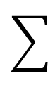
More Significant Position
4⁷ | 4⁶ | 4⁵ | 4⁴ | 4³ | 4² | 4¹ | 4⁰
3 | 0 | 3 | 0 | 2 | 1 | 3 | 1
3×4⁷ | 0×4⁶ | 3×4⁵ | 0×4⁴ | 2×4³ | 1×4² | 3×4¹ | 1×4⁰
 |  |  |  |  |  |  |  | 65,437
×
Notes:
3×4^7+ 3×4^6+ 3×4^5+ 3×4^4+ 2×4^3+ 1×4^2+ 3×4^1+ 1×4^0 =65437

Slide 67
More Significant Position
 |  | 3 | 0 | 3 | 0 | 2 | 1 | 3 | 1 | 65,437
 |  |  |  |  | 3 | 3 | 3 | 3 | 1 | ?
 |  |  |  | 3 | 3 | 3 | 3 | 3 | 2 | ?
 |  | 3 | 0 | 0 | 3 | 3 | 3 | 3 | 0 | ?
3 | 3 | 3 | 3 | 3 | 3 | 3 | 3 | 3 | 3 | ?
Notes:
3×4^4+ 3×4^3+ 3×4^2+ 3×4^1+ 0×4^0 =1020
https://www.tools4noobs.com/online_tools/base_convert/

Slide 68
More Significant Position
 |  | 3 | 0 | 3 | 0 | 2 | 1 | 3 | 1 | 65,437
 |  |  |  |  | 3 | 3 | 3 | 3 | 1 | 1,021
 |  |  |  | 3 | 3 | 3 | 3 | 3 | 2 | ?
 |  | 3 | 0 | 0 | 3 | 3 | 3 | 3 | 0 | ?
3 | 3 | 3 | 3 | 3 | 3 | 3 | 3 | 3 | 3 | ?
Notes:
3×4^4+ 3×4^3+ 3×4^2+ 3×4^1+ 1×4^0 =1020
https://www.tools4noobs.com/online_tools/base_convert/

Slide 69
More Significant Position
 |  | 3 | 0 | 3 | 0 | 2 | 1 | 3 | 1 | 65,437
 |  |  |  |  | 3 | 3 | 3 | 3 | 1 | 1,021
 |  |  |  | 3 | 3 | 3 | 3 | 3 | 2 | 4,094
 |  | 3 | 0 | 0 | 3 | 3 | 3 | 3 | 0 | 50,172
3 | 3 | 3 | 3 | 3 | 3 | 3 | 3 | 3 | 3 | 1,048,575

Slide 70
More Significant Position
 |  |  |  |  |  |  |  |  |  | Base-4 | Hossein’s Number System
 |  | 3 | 0 | 3 | 0 | 2 | 1 | 3 | 1 | 65,437 | -
 |  |  |  |  | 3 | 3 | 3 | 3 | 1 | 1,021 | 17
 |  |  |  | 3 | 3 | 3 | 3 | 3 | 2 | 4,094 | 22
 |  | 3 | 0 | 0 | 3 | 3 | 3 | 3 | 0 | 50,172 | -
3 | 3 | 3 | 3 | 3 | 3 | 3 | 3 | 3 | 3 | 1,048,575 | 39

Slide 71
0 | 0 | … | 0 | 0 | 0
Min
Radix-4
Base-4
n positions
Max
3 | 3 | … | 3 | 3 | 3 | ?

Slide 72
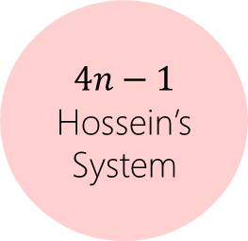
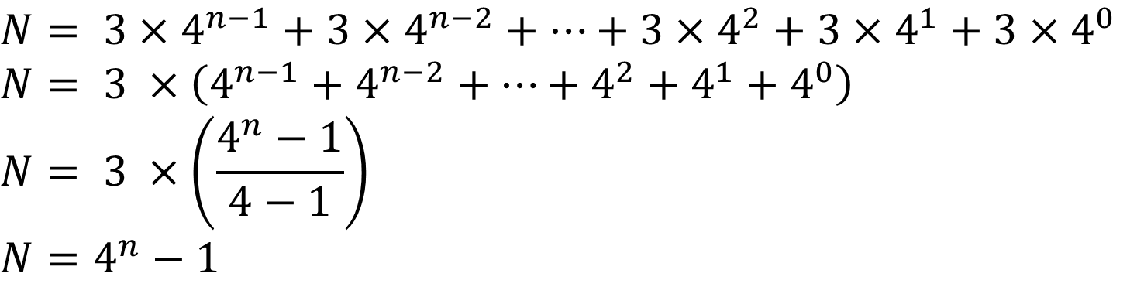
$$N= 3×4^{n−1}+3×4^{n−2}+…+3×4^{2}+3×4^{1}+3×4^{0}$$
$$N= 3 ×\left(4^{n−1}+4^{n−2}+…+4^{2}+4^{1}+4^{0}\right)$$
$$N= 3 ×\left(\frac{4^{n}−1}{4−1}\right)$$
$$N=4^{n}−1$$
$$4n−1$$
Hossein’s System
n positions
Max
4^{n-1} | 4^{n-2} |  | 4² | 4¹ | 4⁰
3 | 3 | … | 3 | 3 | 3 | N

Slide 73
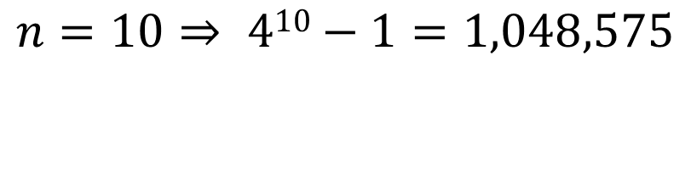
$$n=10⇒ 410−1=1,048,575$$
10 positions
Max
3 | 3 | … | 3 | 3 | ?

Slide 74
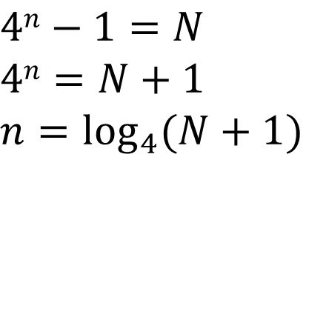
$$4n−1=N$$
$$4n=N+1$$
$$n=\log_{4}{(N+1)}$$
? positions
Max
3 | 3 | … | 3 | 3 | N

Slide 75
how many positions to represent the moon’s distance to the sun in Base-4 system if an Oracle said it is ~150 million km and earth’s diameter is ~13,000 km?

Slide 76
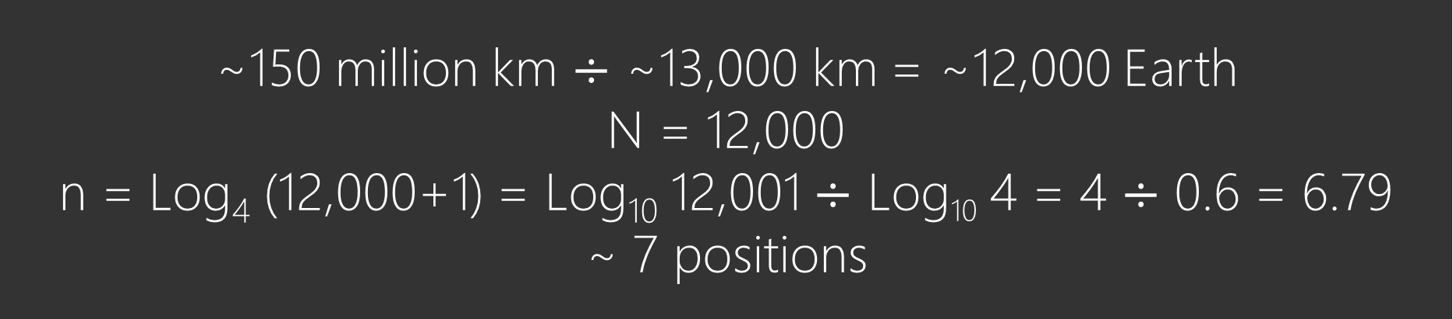
~150 million km $÷$ ~13,000 km = ~12,000 Earth
N = 12,000
n = Log₄ (12,000+1) = Log₁₀ 12,001 $÷$ Log₁₀ 4 = 4 $÷$ 0.6 = 6.79
~ 7 positions
IIIIIIIIIIIIIIIIIIIIIIIIIIIIIIIIIIIIIIIIIIIIIIIIIIIIIIIIIIIIIIIIIIIIIIIIIII
IIIIIIIIIIIIIIIIIIIIIIIIIIIIIIIIIIIIIIIIIIIIIIIIIIIIIIIIIIIIIIIIIIIIIIIIIII
IIIIIIIIIIIIIIIIIIIIIIIIIIIIIIIIIIIIIIIIIIIIIIIIIIIIIIIIIIIIIIIIIIIIIIIIIII
IIIIIIIIIIIIIIIIIIIIIIIIIIIIIIIIIIIIIIIIIIIIIIIIIIIIIIIIIIIIIIIIIIIIIIIIIII
3333333333333333333333333333333333333333
???????
Notes:
For the instructor to start the poll:
https://directpoll.com/c?XDVhEt59x2nMuWEWMsPyI4JjAMFnDPxY8
For the instructor to show the replies and correct answer:
https://www.directpoll.com/r?XDbzPBd3ixYqg8XgchMp4tObJpS7kJlGp1oGe4VDd5
For students: http://etc.ch/mYUq
Logarithm base change rule log_{b}(x) = log_{c}(x) / log_{c}(b)

Slide 77
~150 million km $÷$ ~13,000 km = ~12,000 Earth
N = 12,000
n = Log₄ (12,000+1) = Log₁₀ 12,001 $÷$ Log₁₀ 4 = 4 $÷$ 0.6 = 6.79
~ 7 positions
IIIIIIIIIIIIIIIIIIIIIIIIIIIIIIIIIIIIIIIIIIIIIIIIIIIIIIIIIIIIIIIIIIIIIIIIIII
IIIIIIIIIIIIIIIIIIIIIIIIIIIIIIIIIIIIIIIIIIIIIIIIIIIIIIIIIIIIIIIIIIIIIIIIIII
IIIIIIIIIIIIIIIIIIIIIIIIIIIIIIIIIIIIIIIIIIIIIIIIIIIIIIIIIIIIIIIIIIIIIIIIIII
IIIIIIIIIIIIIIIIIIIIIIIIIIIIIIIIIIIIIIIIIIIIIIIIIIIIIIIIIIIIIIIIIIIIIIIIIII
3333333333333333333333333333333333333333
???????

Slide 78
N = 12,000 → (2323200)₄
We’ll see how to convert from decimal to base-4 or any other number systems later. Stay tuned!
IIIIIIIIIIIIIIIIIIIIIIIIIIIIIIIIIIIIIIIIIIIIIIIIIIIIIIIIIIIIIIIIIIIIIIIIIII
IIIIIIIIIIIIIIIIIIIIIIIIIIIIIIIIIIIIIIIIIIIIIIIIIIIIIIIIIIIIIIIIIIIIIIIIIII
IIIIIIIIIIIIIIIIIIIIIIIIIIIIIIIIIIIIIIIIIIIIIIIIIIIIIIIIIIIIIIIIIIIIIIIIIII
IIIIIIIIIIIIIIIIIIIIIIIIIIIIIIIIIIIIIIIIIIIIIIIIIIIIIIIIIIIIIIIIIIIIIIIIIII
3333333333333333333333333333333333333333
2323200

Slide 79

Question

